Slide 1
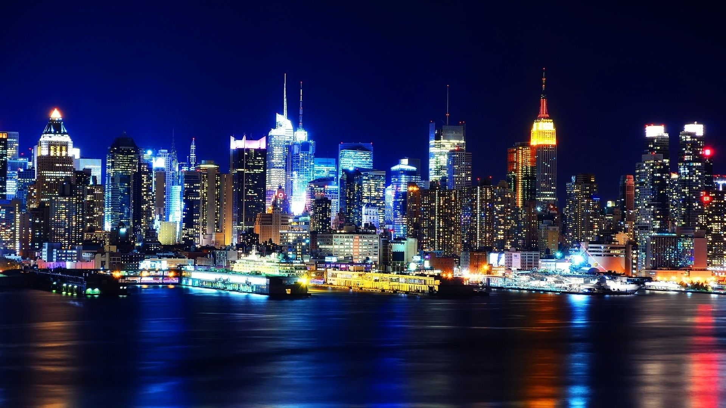
New York Uber Analysis
Lichen Yan
ly266@scarletmail.rutgers.edu

Slide 2
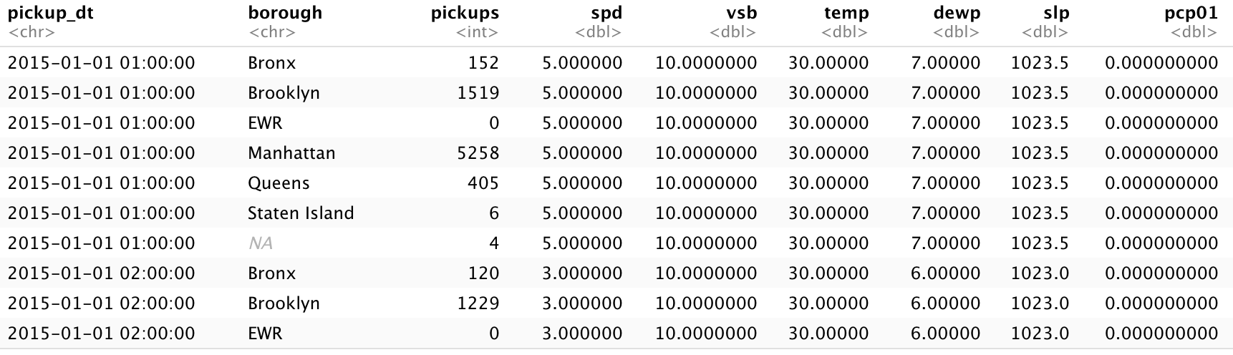
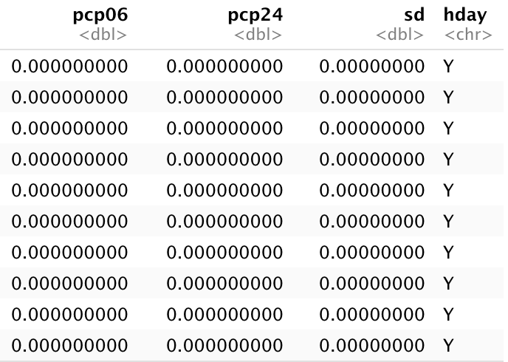
Dataset descriptions
Resource: https://www.kaggle.com/yannisp/uber-pickups-enriched
Uber Pickups in New York City, from 01/01/2015 to 30/06/2015
Rows: 29,101

Slide 3
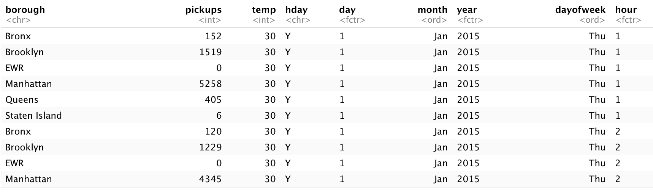
Drop the columns(spd, vsb, dewp, slp, pcp01, pcp06, pcp24, sd)
Separate the column pickup_dt by new variables: hour, day, dayofweek, month, year.
Drop the variable pickup_dt and drop all the NAs
Rows: 26,058

Slide 4
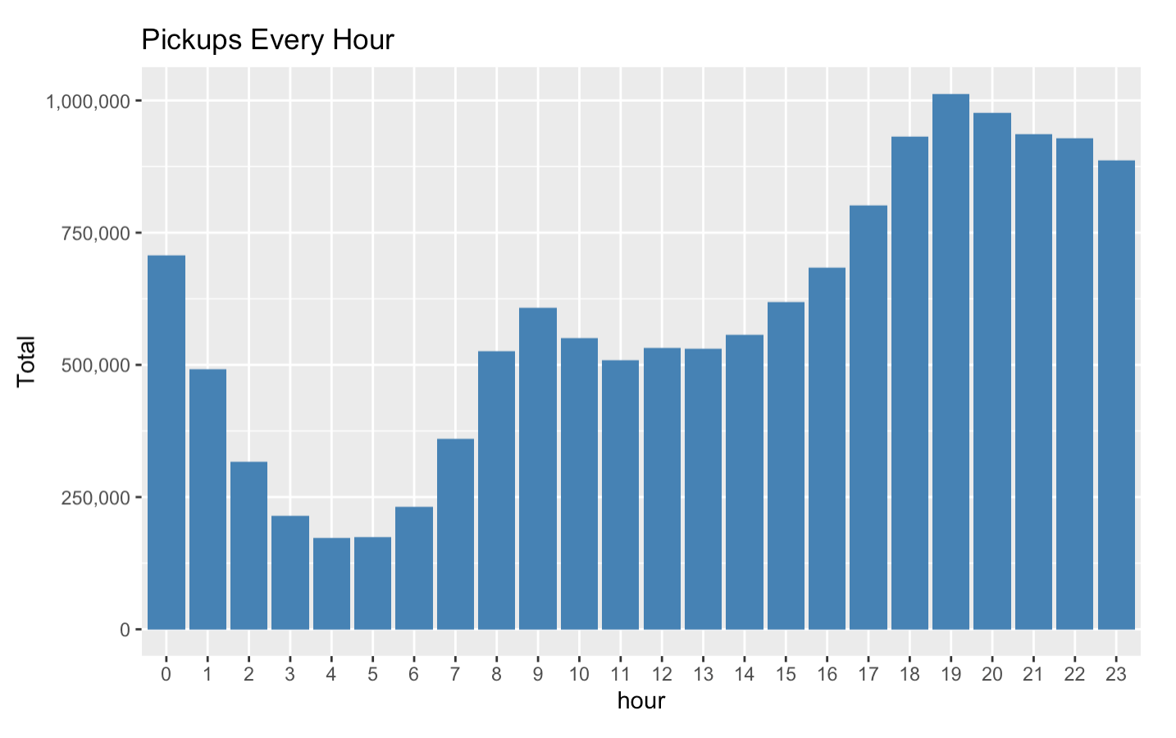
Suggestion: best working time would be between 5pm – 1am

Slide 5
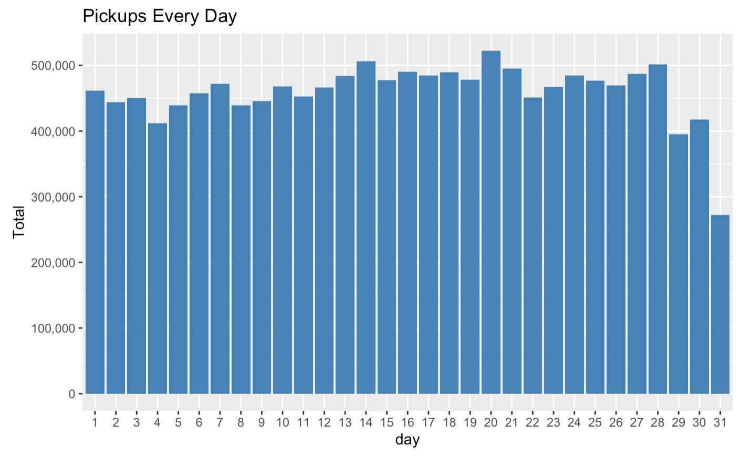
Conclusion: which day in a month won’t effect pickup number that much.

Slide 6
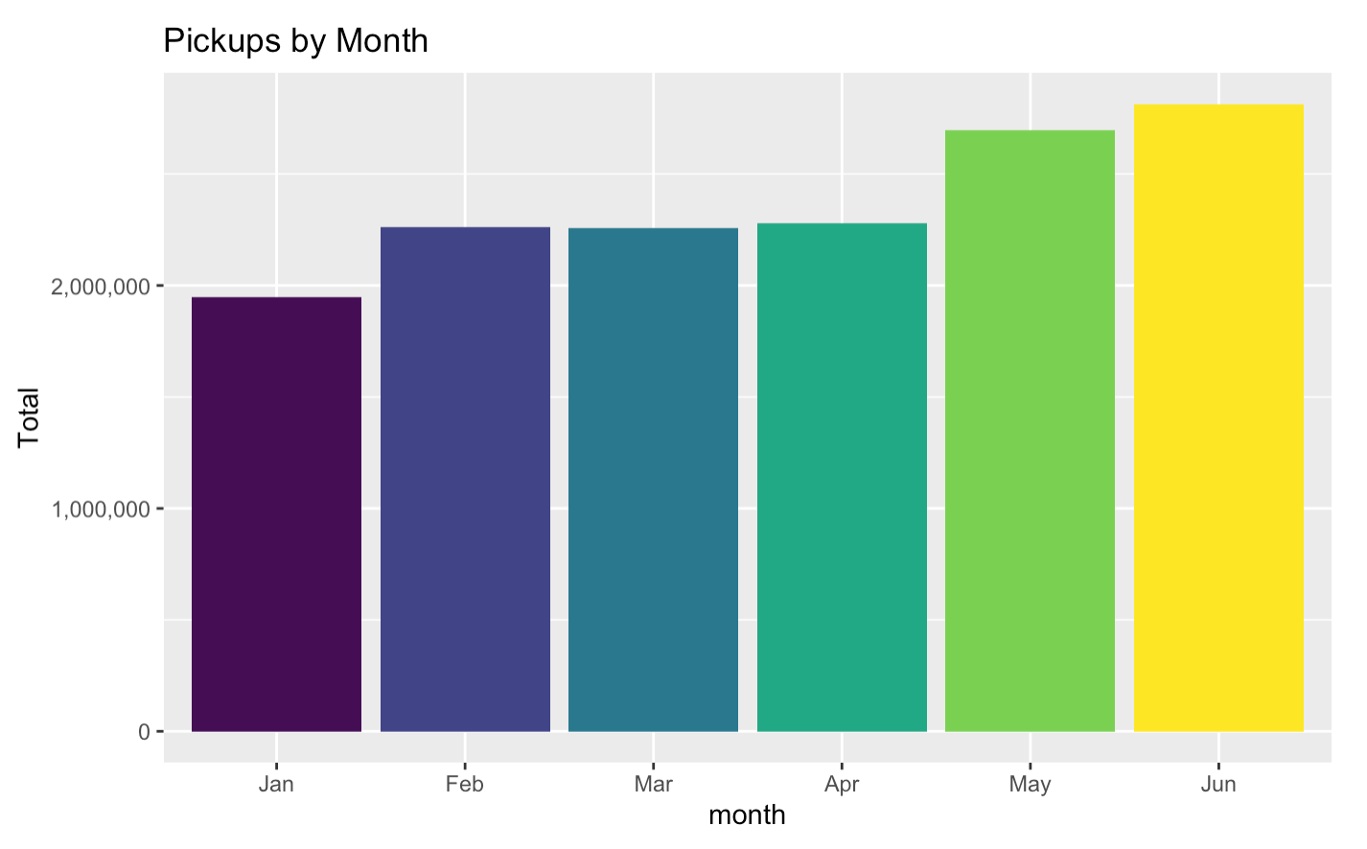
Conclusion: people are taking Uber more on May and Jun

Slide 7
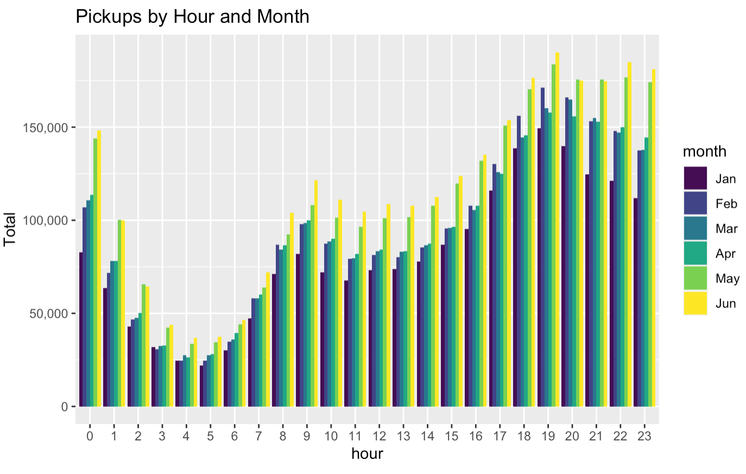
Conclusion: No on certain time, there are more pickups on May and Jun for every hour

Slide 8
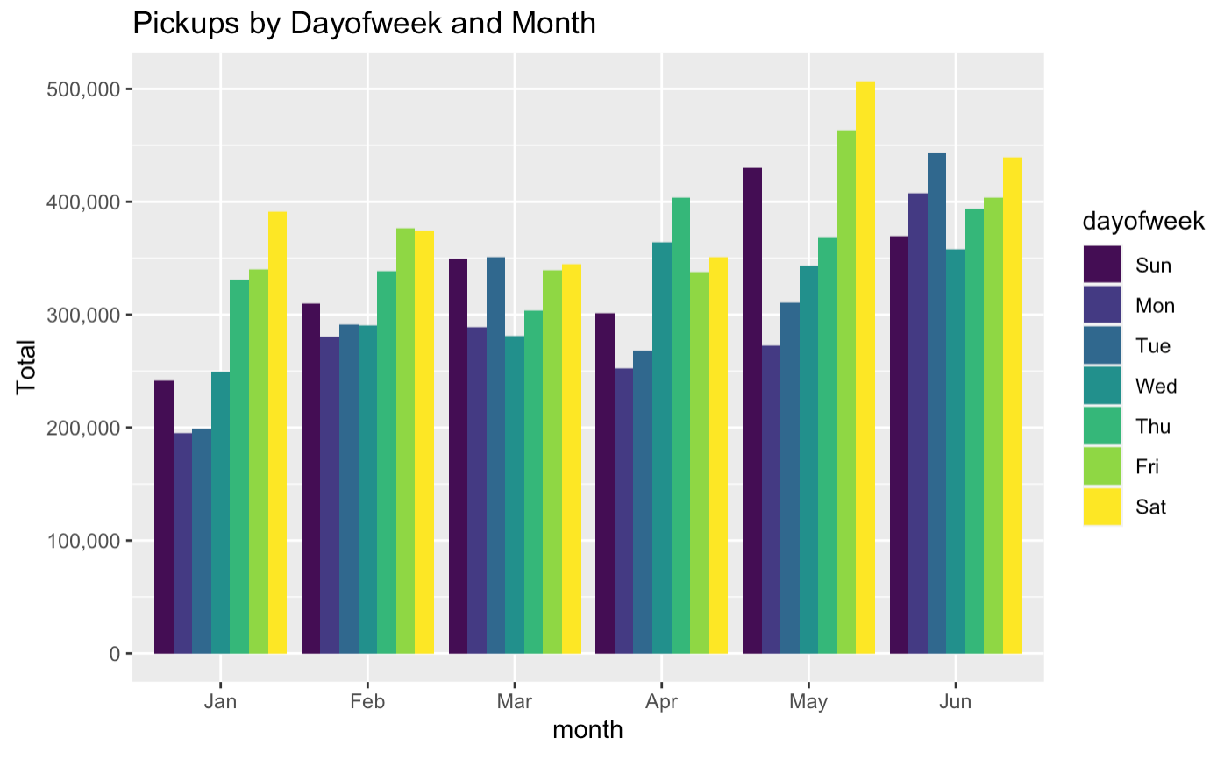
Conclusion: there are more pickups on Sat and Sun

Slide 9
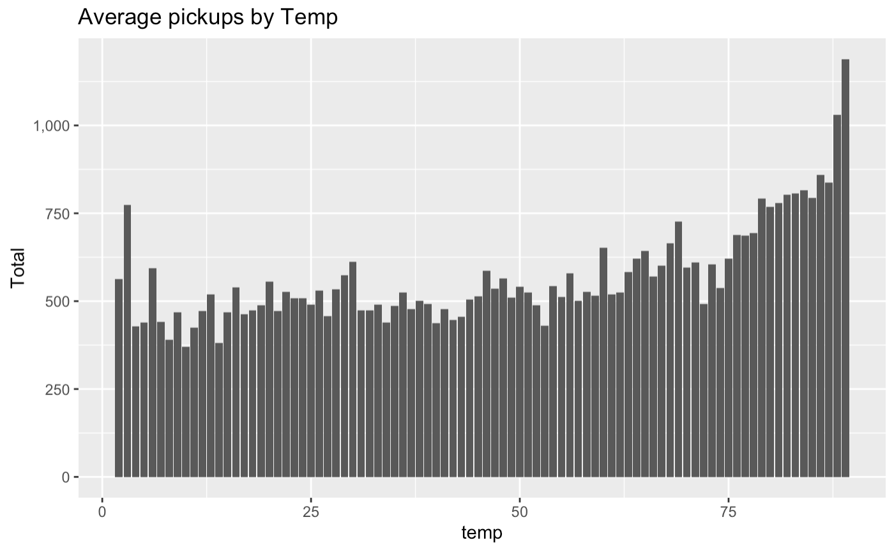
Conclusion: People are more likely to take Uber while in extreme weather

Slide 10
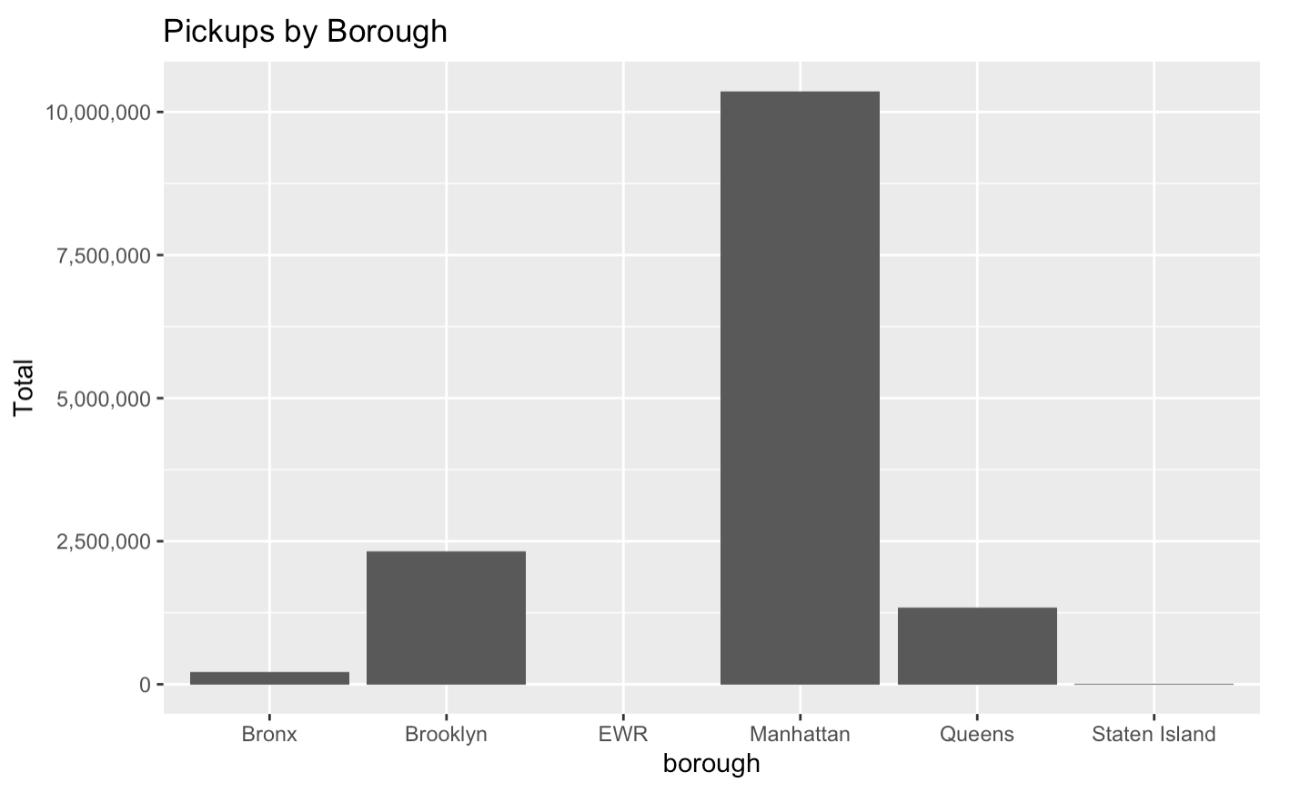
Conclusion: Manhattan have the most high pickups

Slide 11
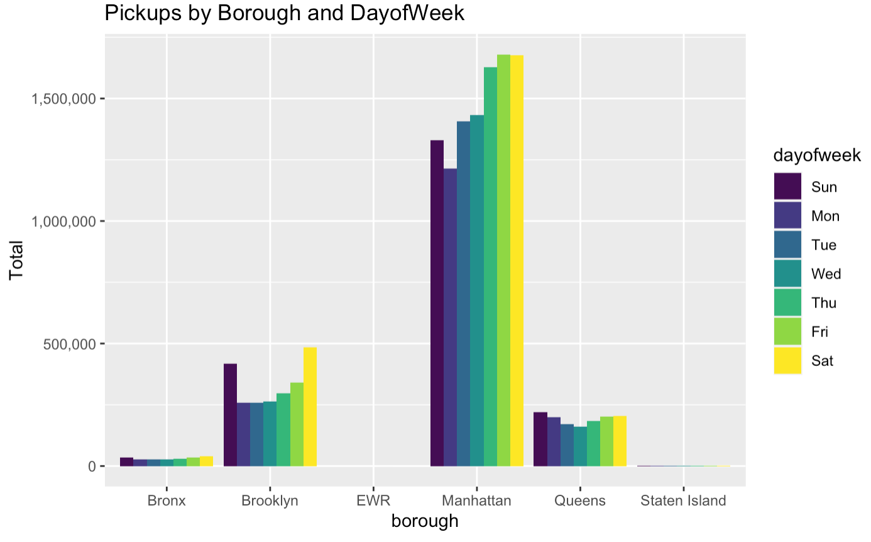

Slide 12
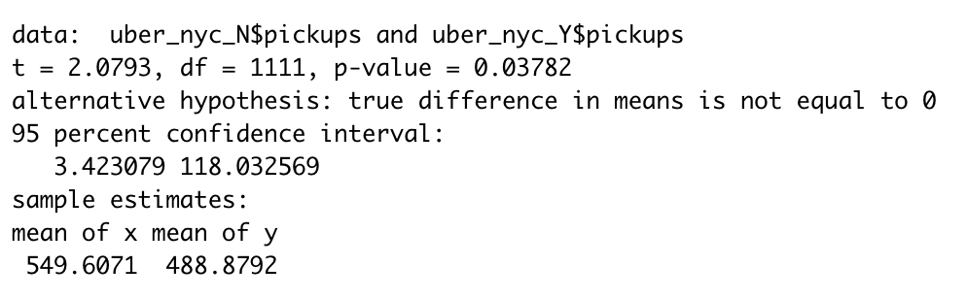
Conclusion: there exist a large difference between the pickup on holiday and non-holiday

Slide 13
Final suggestion for Uber driver in NY
People are more likely to take Uber on Friday to Sunday.
Manhattan have the largest volume of potential customers than all other borough together.
5pm – 1am would be the best working hour.
In extreme weather, people are more likely to take Uber for the trip.
Holiday have lower customer volume than non-holiday.

